Slide 1
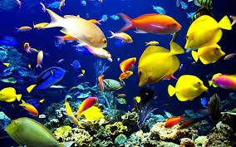
Multiclass Fish Image Classification
Domain: Image Classification
Tools: Python, TensorFlow, Keras, Streamlit
https://fishvision.streamlit.app/
Developed by: Santhiya Baskar

Slide 2




Project Objective
Build Classification Model
Create User-Friendly Interface
Develop a robust deep learning model capable of accurately classifying fish images into their correct species using convolutional neural networks.
Design and deploy a simple, intuitive web application using Streamlit that enables users to upload fish images and receive instant species predictions.
Optimize for Deployment
Implement a lightweight TensorFlow Lite model to ensure fast inference times and efficient deployment on cloud infrastructure.

Slide 3
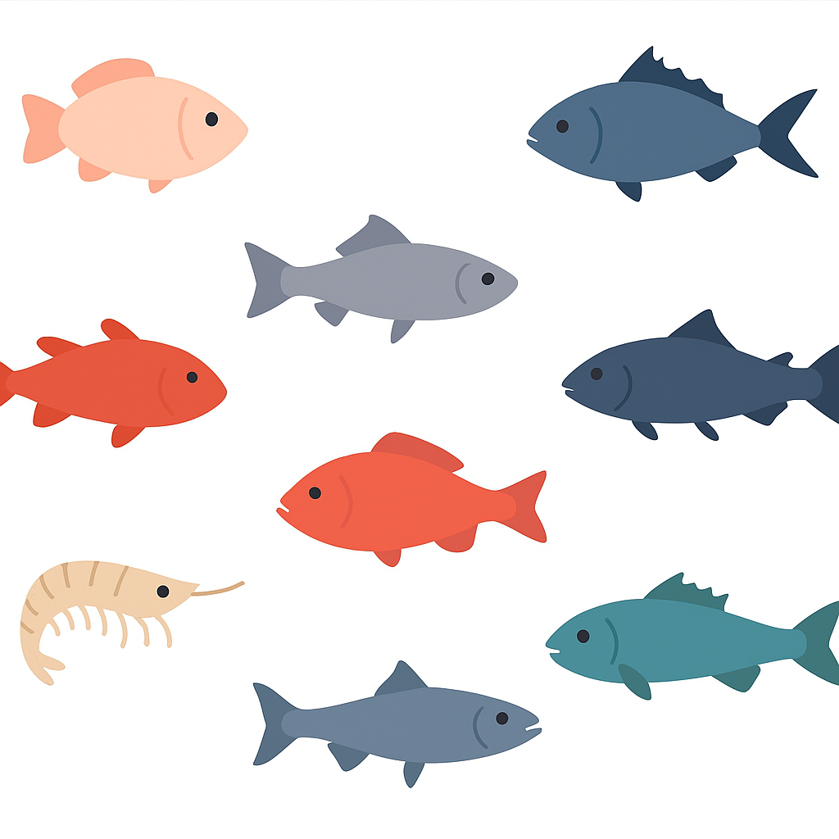
Problem Statement
Identifying fish species manually is difficult, time-consuming, and often inaccurate.
Fisheries and marine researchers rely on expert knowledge, which can lead to human error, especially when dealing with visually similar fish species.
There is a strong need for an automated, accurate, and fast classification system to identify fish species from images.
Solution
The FishVision system uses deep learning and computer vision to automatically classify fish species from images.
By training a Convolutional Neural Network (CNN) on multiple fish classes, converting it to TensorFlow Lite, and deploying it via Streamlit Cloud, the project provides:
Quick and reliable fish identification
An easy-to-use web interface for global access
Lightweight and efficient performance
Manual Identification Limitations
Accuracy Concerns
Solution Need
Time-consuming processes requiring expert knowledge
Human error and inconsistency in visual assessment
Automated system for quick and reliable species detection

Slide 4


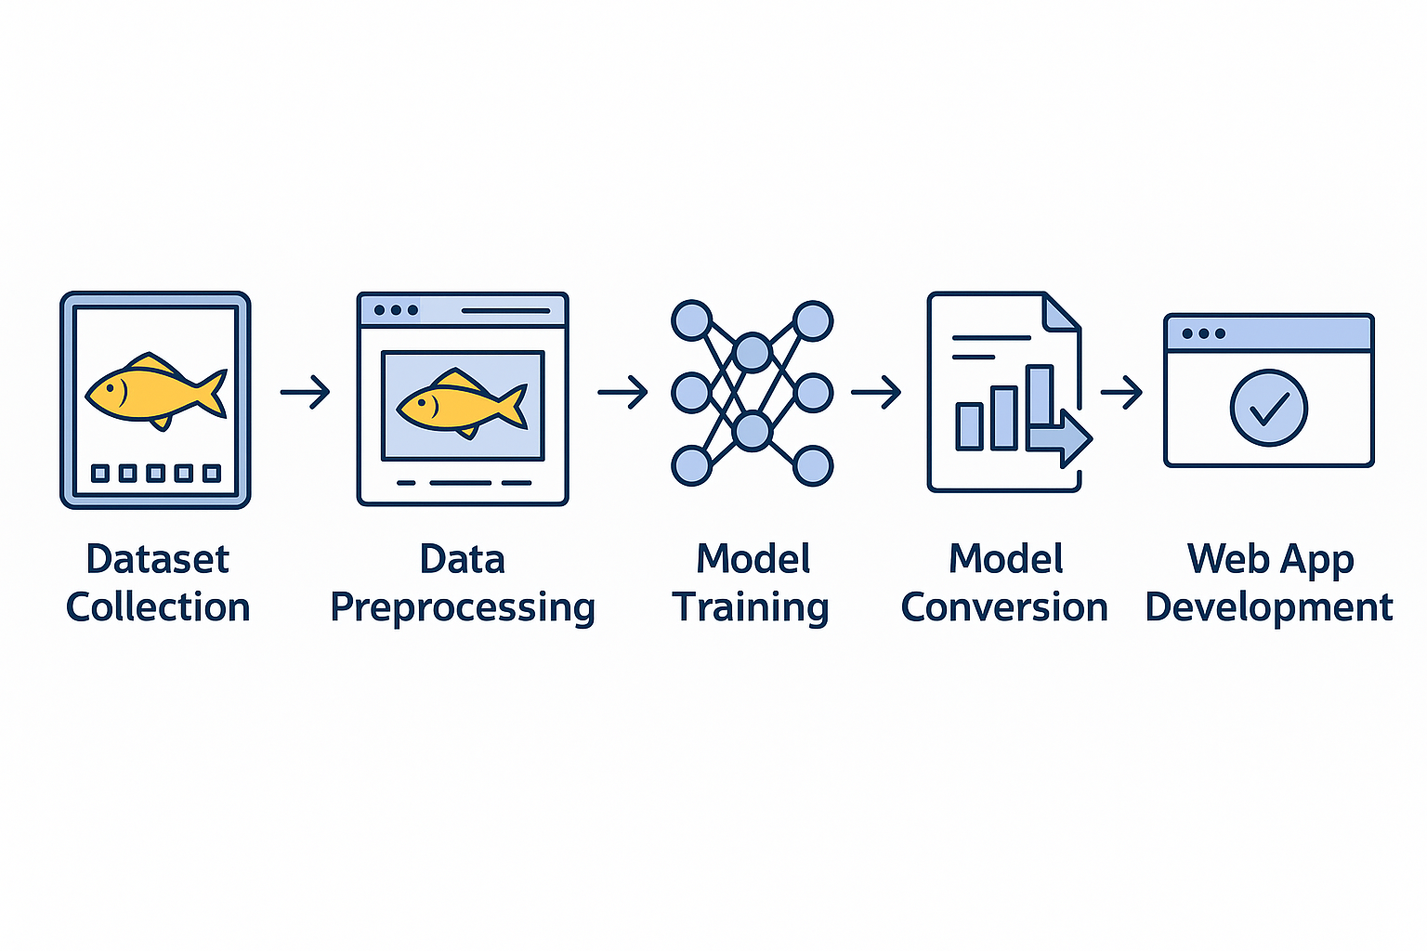




Project Workflow
A systematic approach to building and deploying an intelligent fish classification system from data collection to cloud deployment.
Dataset Collection
Gathered comprehensive fish images spanning 9 distinct species for training
Data Preprocessing
Resized images, normalized pixel values, and applied augmentation techniques
Model Training
Built and optimized CNN architecture using TensorFlow and Keras frameworks
Model Conversion
Converted trained model to TensorFlow Lite format for efficient deployment
Web App Development
Created interactive Streamlit interface with prediction capabilities
Cloud Deployment
Deployed application on Streamlit Cloud for global accessibility

Slide 5

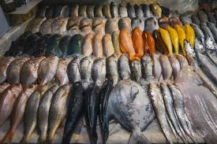
Dataset Specifications
Dataset Overview
Fish Species Classes
The model was trained on a curated dataset containing 9 fish species after careful preprocessing and class selection.
Black Sea Sprat
Gilt Head Bream
Image dimensions: 224×224 pixels
Horse Mackerel
Training split: 80% for model training
Red Mullet
Testing split: 20% for validation
Red Sea Bream
Format: Standardized RGB images
Sea Bass
Shrimp
Striped Red Mullet
Trout

Slide 6

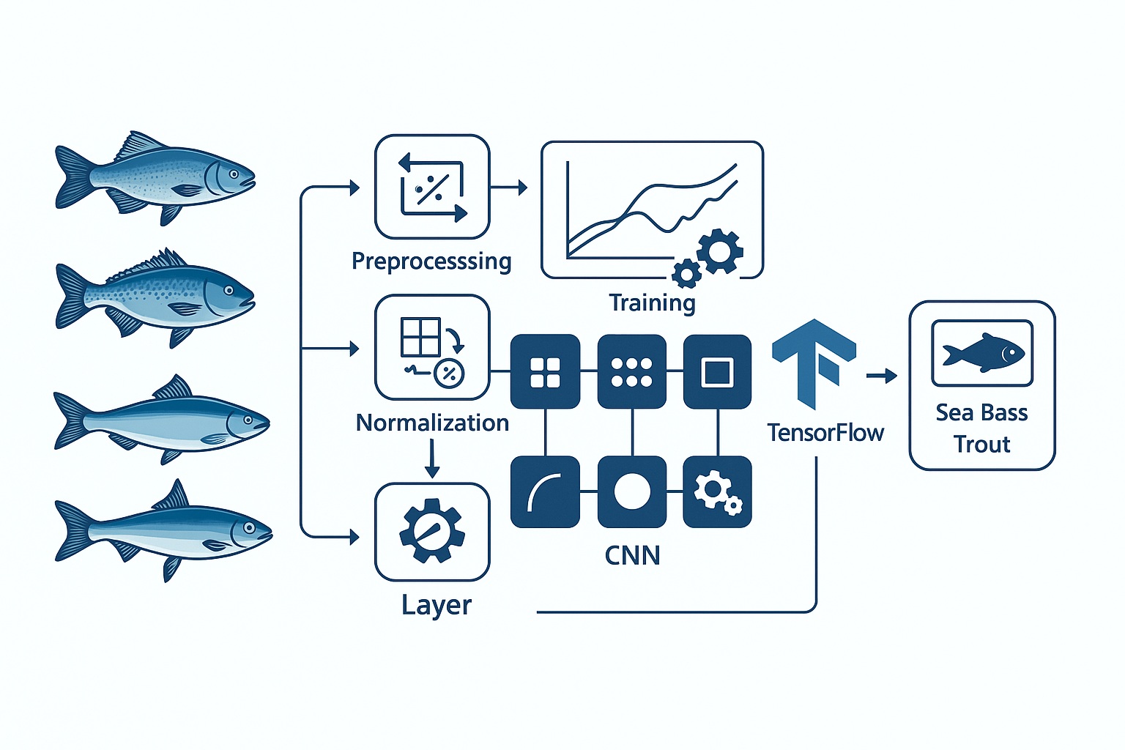


Model Architecture & Training
CNN Architecture
Built deep convolutional neural network with multiple layers for feature extraction and pattern recognition
Training Process
Trained model across multiple epochs, continuously monitoring accuracy, loss metrics, and confusion matrix
Model Optimization
Converted to TensorFlow Lite format for faster inference and reduced model size
Technical Implementation
Model Assets
Framework: TensorFlow/Keras
Trained model: .tflite format
Architecture: Custom CNN
Label mapping: labels.txt file
Optimization: Adam optimizer
Evaluation metrics recorded
Loss function: Categorical crossentropy
Confusion matrix analysis

Slide 7
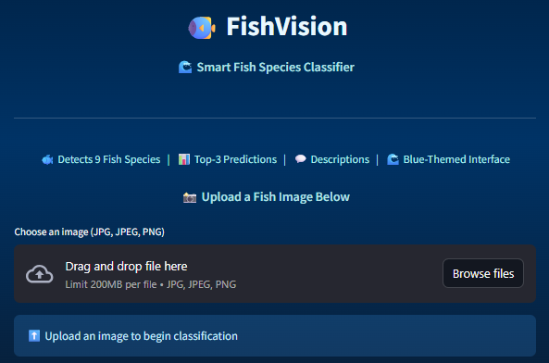


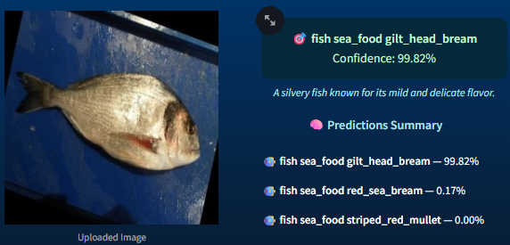


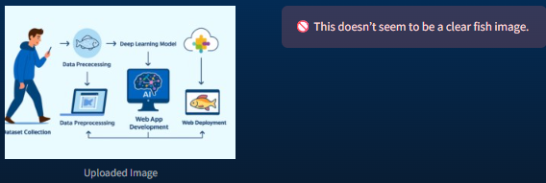

Streamlit Application Interface
An intuitive, visually appealing web application that brings machine learning predictions to end users through a seamless interaction experience.
Image Upload
Users can easily upload fish images through a drag-and-drop interface or file browser selection
Species Prediction
AI model analyzes the image and returns the predicted species with confidence percentage
Top 3 Results
Displays the three most likely species predictions with their respective confidence scores
Fish Description
Provides detailed information about the identified fish species for educational purposes
Design Features: The application features a clean blue-themed interface with robust error handling for unclear or invalid images, ensuring a smooth user experience.

Slide 8




Features & Advantages
Key Features
Core Advantages
1
Multi-Species Detection
Universal Access
Accurately identifies 9 different fish species
Works from anywhere with internet connectivity
2
Confidence Scoring
Displays prediction confidence percentages
High Performance
Fast predictions using lightweight TFLite model
3
Educational Content
Provides detailed species descriptions
Educational Value
Perfect tool for students and researchers
4
Cloud-Based Access
Available online via Streamlit Cloud
User-Friendly
Clean, intuitive one-page design

Slide 9




Key Takeaways &
Learning Journey
Technical Mastery
End-to-End Implementation
Gained comprehensive understanding of image data processing, preprocessing techniques, and classification using deep learning architectures. Learned to work with CNNs and optimize them for real-world applications.
Developed skills in model conversion to TensorFlow Lite format, cloud deployment strategies, and debugging production issues independently. Successfully bridged the gap between model development and deployment.
Professional Growth
Built confidence in implementing real-time AI solutions and strengthened problem-solving abilities. These learnings form a strong foundation for future machine learning projects and continuous skill improvement.
"This project transformed theoretical knowledge into practical expertise, teaching me that successful deployment requires not just a good model, but also thoughtful user experience design and robust error handling."

Slide 10

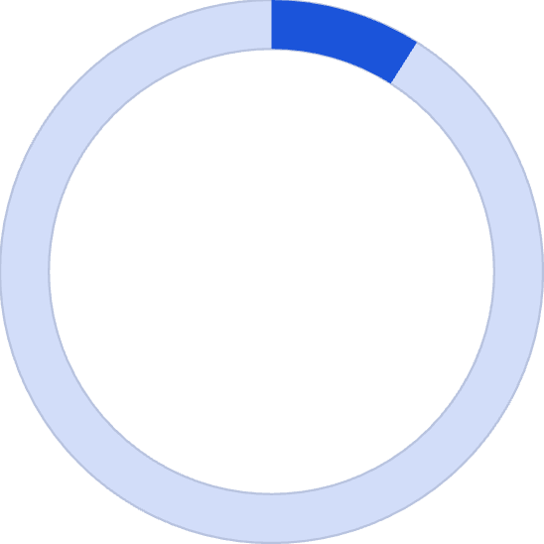

Results, Applications & Future Roadmap
Project Results
Applications
Future Enhancements
Marine Research
01
Species recognition and biodiversity studies
Expand Dataset
Add more fish categories and species
85%
Education
02
Interactive learning tool for students
Improve Accuracy
Fish Industry
Implement advanced CNN architectures
Classification Accuracy
Automated classification for commercial use
03
Real-Time Detection
Enable live camera prediction capability
04
9
Mobile Platform
Develop dedicated mobile application
Species Detected
Successfully deployed on Streamlit Cloud
Clean, intuitive output display
Detailed fish species information

